Slide 1
Module 1: Different DBs for Different Requirements
Text chapters 1 and 2

Slide 2
Module 1 - Overview
This chapter places NoSQL databases in a historical context. Many of the techniques used in NoSQL databases have been used in the past.
Notice that different data management requirements may be best served by different database management systems.
The limitations of earlier database management systems motivated the development of relational database.
The limitations of relational databases provided the motivation for creating NoSQL databases.

Slide 3
Early Database Management Systems
All database models have limitations. Through the history of data management, new database models have been created to address the limitation of earlier models.
Early DBMSs include:
Flat File DMS
Hierarchical DMS
Network DMS

Slide 4
Flat File Data Management Systems
Flat files constitute the first data management systems. They suffered substantial limitations, including the following:
It is inefficient to access data in any way other than by the way data is organized in the file; for example, by customer ID
Changes to file structures require changes to programs
Different kinds of data have different security requirements
Data can be stored in multiple files, making it difficult to maintain consistent sets of data

Slide 5
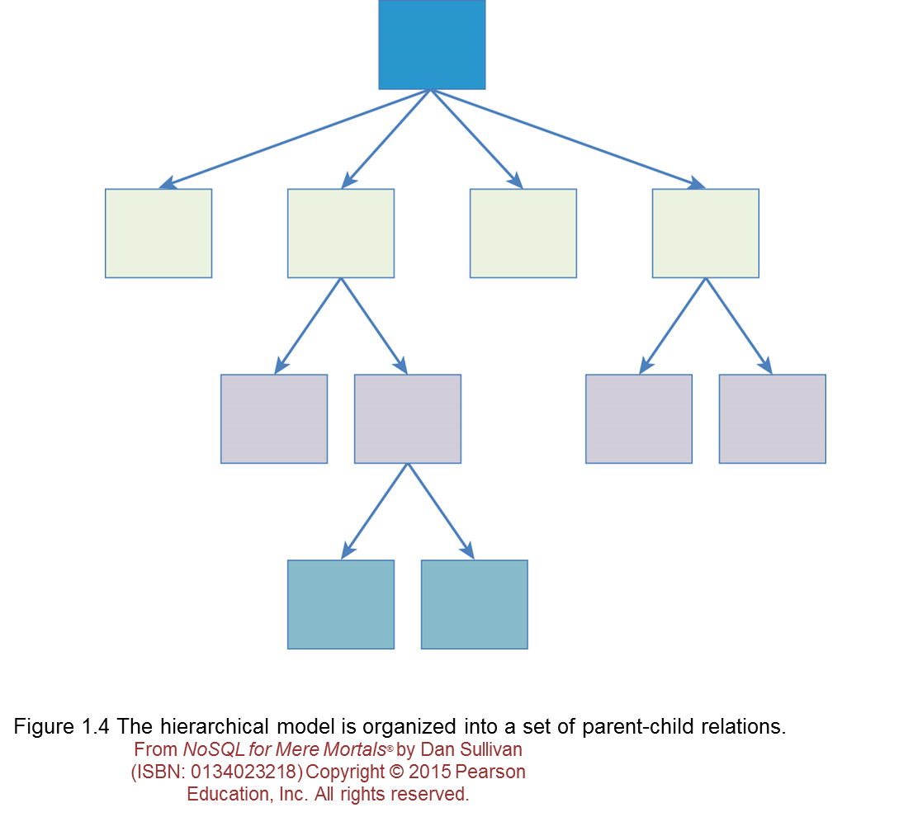
Hierarchical Data Management Systems
Hierarchical databases improved on flat files by organizing related data in hierarchical structures.

Slide 6
Hierarchical Data Management Systems
The following are disadvantages of hierarchical databases:
Can duplicate data
Duplicate data can become inconsistent if one copy is updated but others are not
Potential for errors when aggregating in the presence of duplicate data

Slide 7
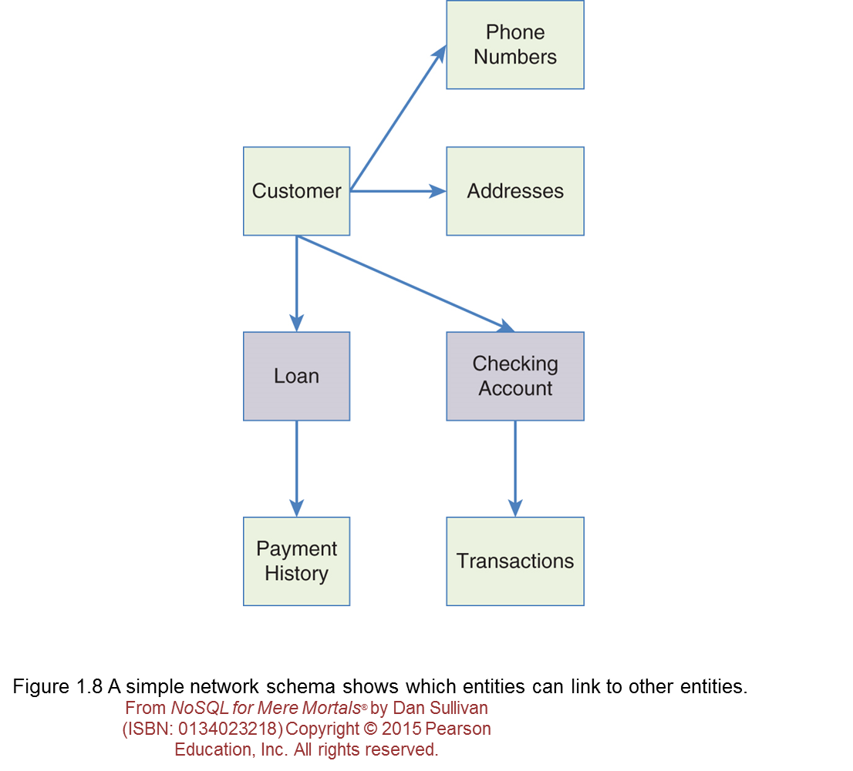
Network Data Management System
Network databases improved on the hierarchical database model. Network databases are not restricted to parent-child relations.

Slide 8
Network Data Management System
The following are disadvantages of network databases:
Difficult to design and maintain
Changes to the database structure may require changes in the way data is retrieved or updated

Slide 9
Relational Database
Relational databases were based on a formal mathematical model that used relational algebra to describe data and their relations.

Slide 10
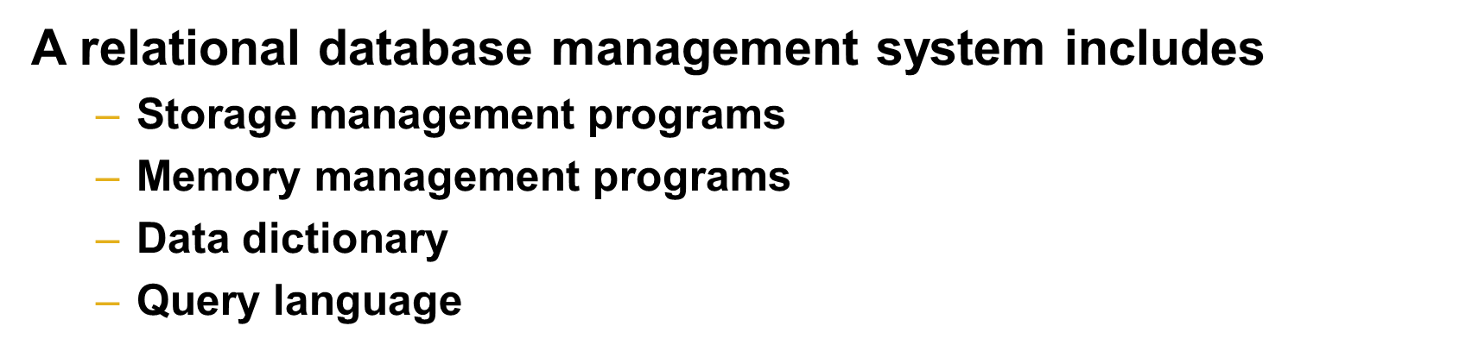
Relational Database
Relational databases separated the logical organization of data structures from the physical storage of those structures.

Slide 11
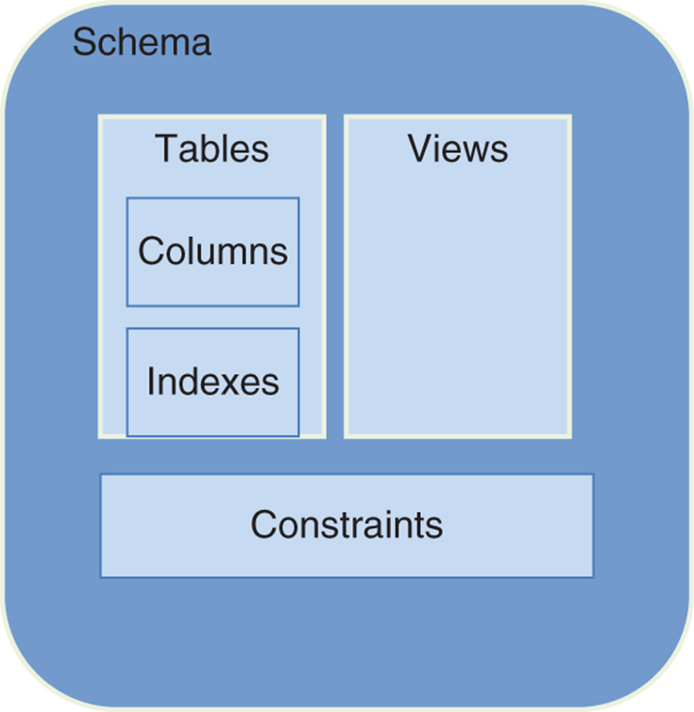
Relational Database
Relational Database models are implemented in a schema
Relational Database strength is its ACID features (atomicity, consistency, isolation, and durability) .

Slide 12
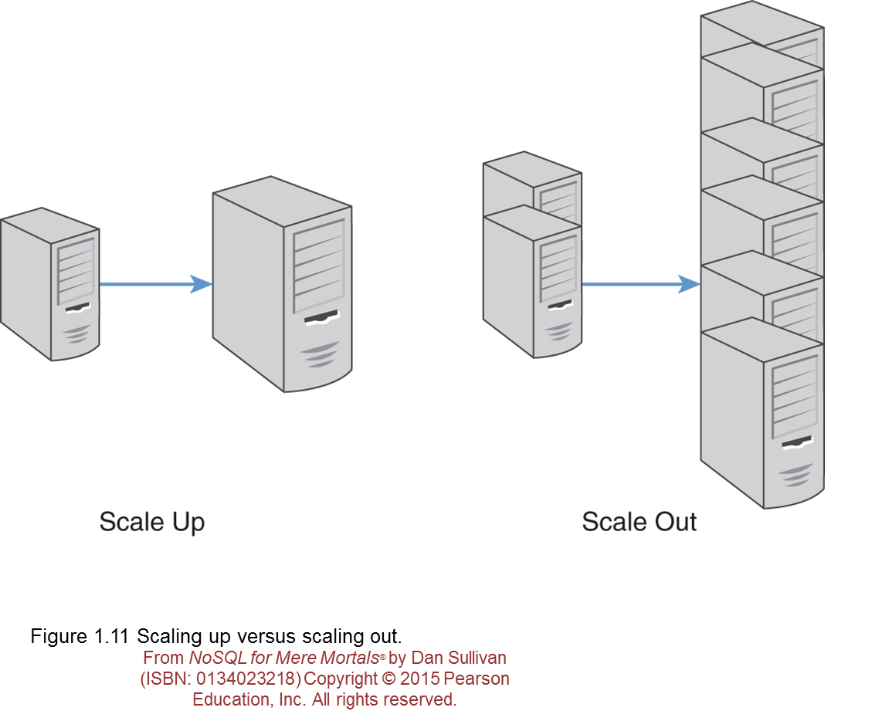
Relational Database
Relational database are difficult to scale horizontally (scale out).

Slide 13
Relational Database
NoSQL databases address four key limitations of relational databases:
Scalability
Cost
Flexibility
Availability

Slide 14
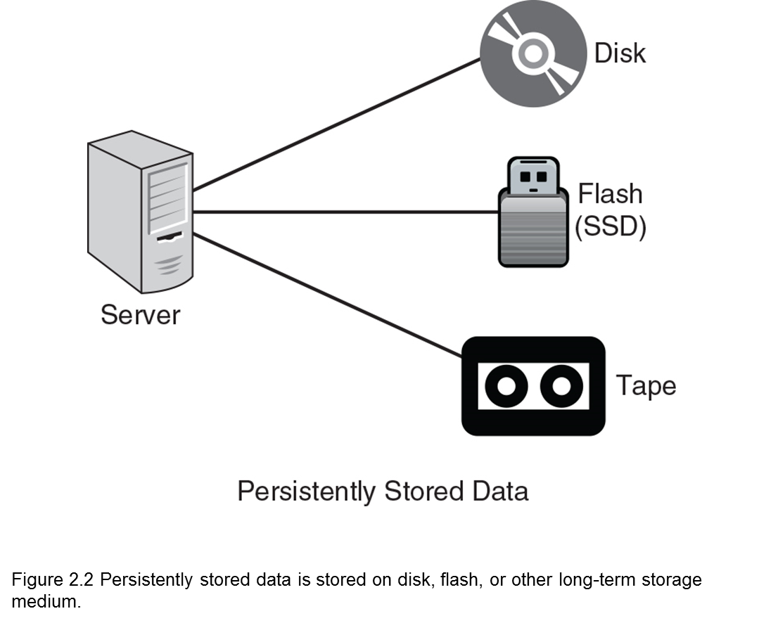
Data Persistence
Data must be stored persistently; that is, it must be stored in a way that data is not lost when the database server is shut down.

Slide 15
Data Consistency
Data Consistency in database systems refers to the requirement that any transaction can only change/alter data in allowed ways.
Any data written to the database must be valid according to all defined rules, including constraints, cascades, triggers, and any combination thereof.
Even Read operations might return inconsistent data if no controls are in place to prevent inconsistent reads.

Slide 16
Data Consistency
Availability is promoted by maintaining multiple copies of data; if one copy become unavailable, other copies can be used to respond to queries.
In distributed databases, there is a trade-off between consistency and availability. Increasing the number of copies improves availability but could require longer times to update, leading to longer periods of inconsistent data

Slide 17
CAP Theorem
The CAP Theorem, also known as Brewer's Theorem, states that distributed databases cannot have consistency (C), availability (A), and partition protection (P) all at the same time.
Consistency, in this case, means consistent copies of data on different servers.
Availability refers to providing a response to any query.
Partition protection means if a network that connects two or more database servers fails, the servers will still be available with consistent data.

Slide 18
ACID vs BASE
ACID features (atomicity, consistency, isolation, and durability) are available in relational databases.
NoSQL databases often support BASE: basically available, soft state, and eventually consistent.

Slide 19
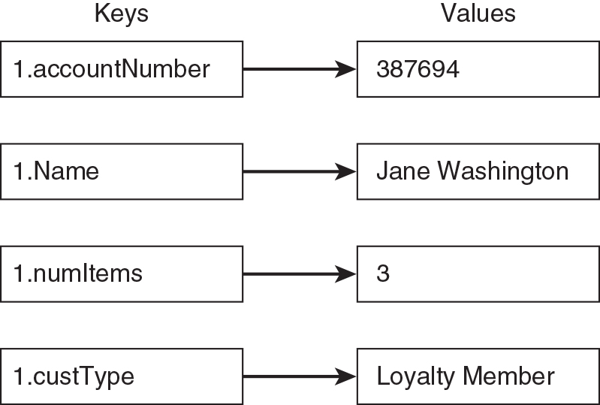
Key –Value Database
Key-value pair databases are the simplest form of NoSQL databases;
they are modeled on two components: keys and values.
Figure 2.11 Key-value databases are modeled on a simple, two-part data structure
consisting of an identifier and a data value.

Slide 20
Document Database
Document databases use a key-value approach to storing multiple key value pairs in groups known as documents.
Documents are typically in a standard format such as JavaScript Object Notation (JSON) or extensible markup language (XML).

Slide 21
Column Family Database
Column family databases share some terms with relational databases, such as rows and columns.
They typically use a map of maps model (that is, the elements of the top-level map are other maps) to store columns and attributes in column families.

Slide 22
Graph Database
Graph databases are the most specialized of the four NoSQL databases
Instead of modeling data using columns and rows, a graph database uses structures called nodes and relations (in more formal discussions they are called vertices and edges).
A node is an object that has an identifier and a set of attributes.
A relation is a link between two nodes that contains attributes about that relation.

